Slide 1
Fisiologia Vegetal Nutrição vegetal
Primeira aula teórica de nutrição vegetal
2020-2021
Teresa Dias – mtdias@fc.ul.pt

Slide 2
Nutrição Vegetal
O objectivo deste bloco de aulas teóricas é dar aos alunos os fundamentos básicos da nutrição vegetal
Objectivos da aula:
1 – Definição de nutriente essencial
2 – Classificação dos nutrients essenciais
3 – Hidroponia e soluções nutritivas
4 – A lei do mínimo
5 – Sintomas de deficiência de nutrientes
Teresa Dias – mtdias@fc.ul.pt

Slide 3
Nutrição Vegetal
Leitura obrigatória

Slide 4
Nutrição Vegetal
Mineral elements, those acquired primarily in the form of inorganic ions, continually cycle through all organisms and their environment. Mineral elements enter the biosphere predominantly through the root systems of plants, so in a sense plants act like the “miners” of Earth’s crust (Epstein 1972, 1994).
Plant mineral nutrition is unique because green plants, the only multicellular autotrophic organisms, can mine inorganic elements from the environment without having to rely on high-energy compounds synthesized by other organisms.
The study of how plants absorb and assimilate inorganic ions is called mineral nutrition; which is central to modern agriculture and environmental protection.

Slide 5
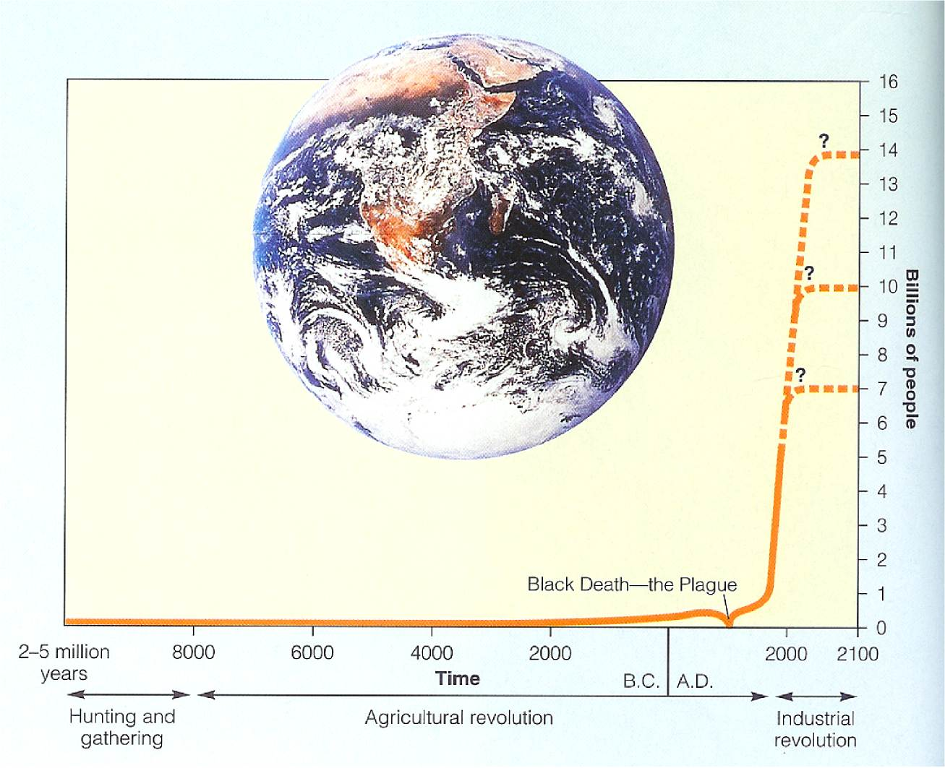
Na realidade, a vida dos quase 8 biliões de pessoas poderia ser melhor sem:
Computadores
600 canais de televisão
Reactores nucleares
Vai-vem espaciais
Redes sociais

Slide 6
Mas a explosão demográfica do século XX e XXI não seria possível sem a descoberta da síntese química da amónia
Fertilização

Slide 7
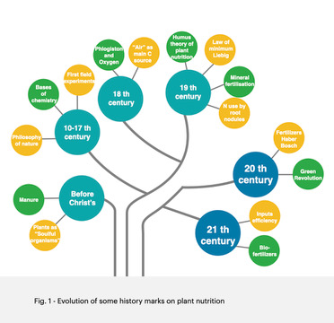
Building blocks
7
Martins-Loução et al. submetido

Slide 8
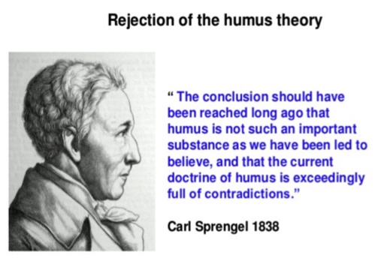
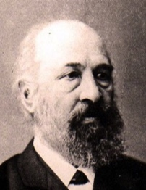
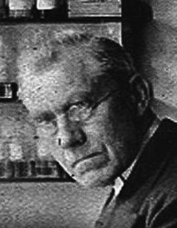
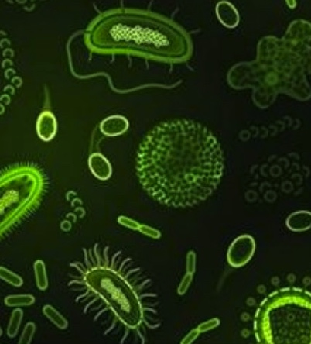
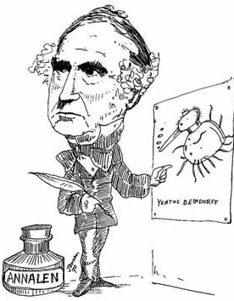
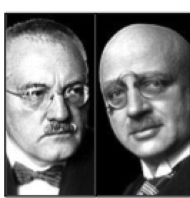
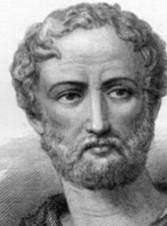
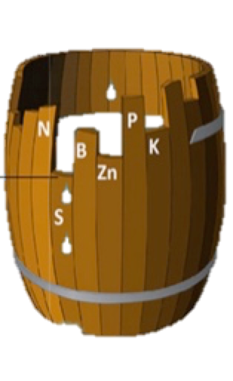
Roots absorb humus and transform it into plant substance (384-322 BC)
1888 – Hellriegel and Wilfarth
Organic matter
Water
Minerals
(N)
Biofertilizers
Building blocks
Regulators
Pliny (23-79 AC)
Growing a crop of lupines improves next crop
Carl Bosch and
Fritz Haber 1900
Justus von Leibig (1844)
Building blocks
8

Slide 9
Because of the complex nature of plant–soil–atmosphere relationships, studies in the area of mineral nutrition involve:
atmospheric chemists
soil scientists
hydrologists
microbiologists
ecologists
plant physiologists

Slide 10
What defines an “essential” element?
In its absence the plant cannot complete a normal life cycle
Has a clear physiological role; the element is part of an essential molecule (macromolecule, metabolite) inside the plant
Most elements fall into both categories above (e.g., structural vs. enzyme cofactor)
These 17 elements are classified as
9 macronutrients
(present at > 10 mmol / kg dry wt.)
8 micronutrients
(< 10 mmol / kg dry wt.)
Arnon and Stout (1939)

Slide 11
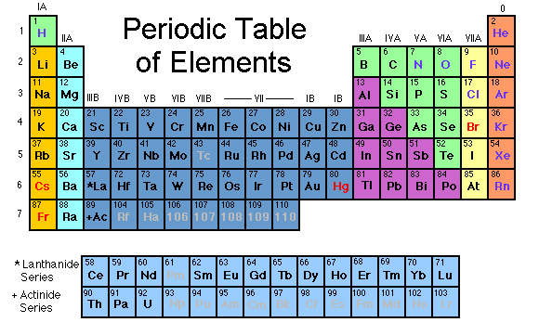
A maior parte das plantas necessita destes elementos para viver:
A química da vida é a química dos elementos leves

Slide 12
I. Plant Nutrients - amount
Macro/Micronutrients
Hydroponics allowed us to see what was needed
According to their concentration in the plant tissue nutrients may be classified in two categories
1. Macronutrients (C, O, H, N, S, P, K, Ca, Mg)
Majority of the time used for the main organic compounds
2. Micronutrients (Cl, Fe, B, Mn, Zn, Cu, Mo, Ni)
Mostly cofactors for particular enzymes (Fe -> Cytochromes

Slide 13
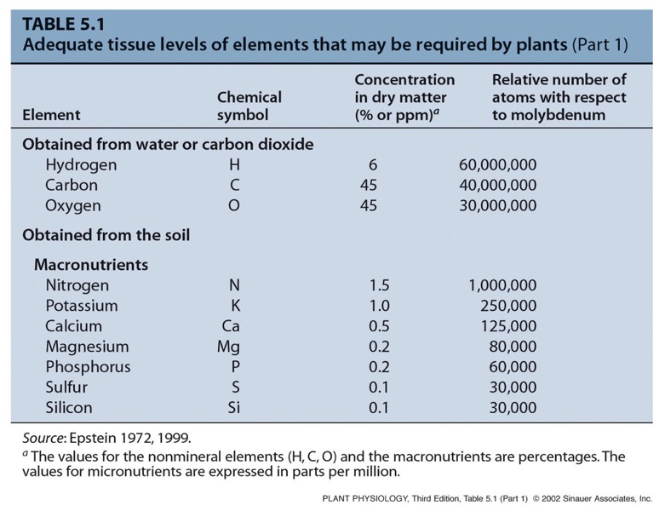
All mineral nutrients together make up less than 4% of plant mass,
yet plant growth is very sensitive to nutrient deficiency
(%)
Not considered mineral nutrients
Notes:
PP05T011.jpg

Slide 14
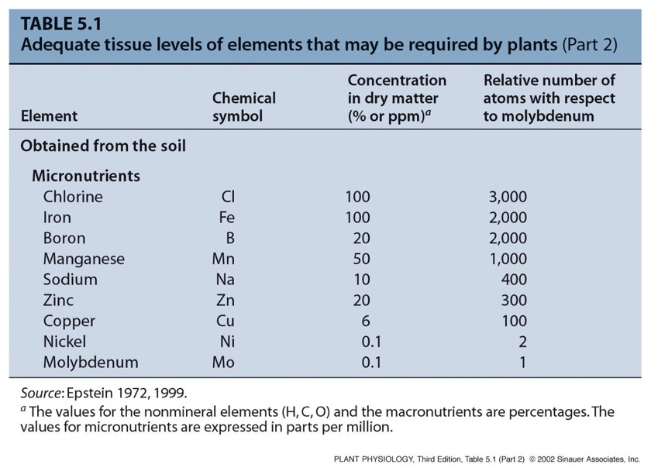
Micronutrients are present in very low concentrations
ppm
Very low concentrations, but still essential
because of specialized roles in metabolism
Notes:
PP05T012.jpg

Slide 15
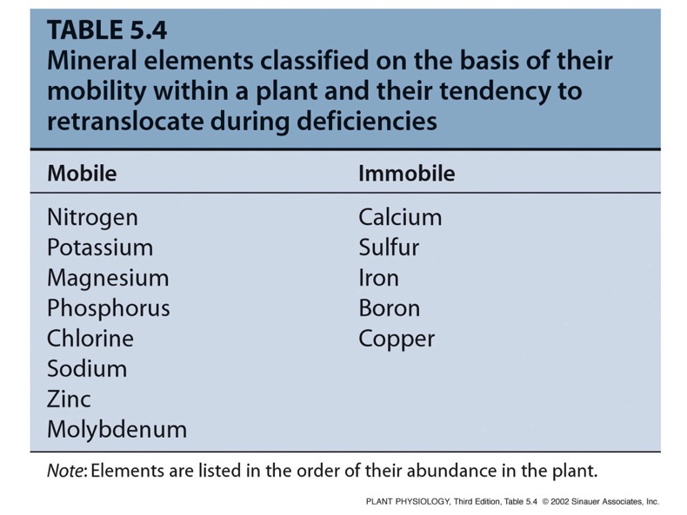
II. Plant Nutrients - mobility
But nutrients can also be classified according to their mobility in the plant

Slide 16
Plant Nutrients –
function
16

Slide 17
Hydroponic culture techniques come in different flavors
Fig. 12.1
Main disadvantage of simple solution culture → as plant grows, it selectively depletes certain minerals
When one becomes limiting, growth will slow significantly
Can grow in vermiculite/perlite (inert, non-nutritive) and refertilize daily
Commercially, it is often cheaper and easier to continuously bathe roots in a nutrient solution (nutrient film technique)
Aerates
Standard nutrient level maintained
Continuous process monitoring
To define “essential”, researchers need inert materials contributing low levels of nutrients (NO METAL PARTS!)
Fig. 12.2

Slide 18
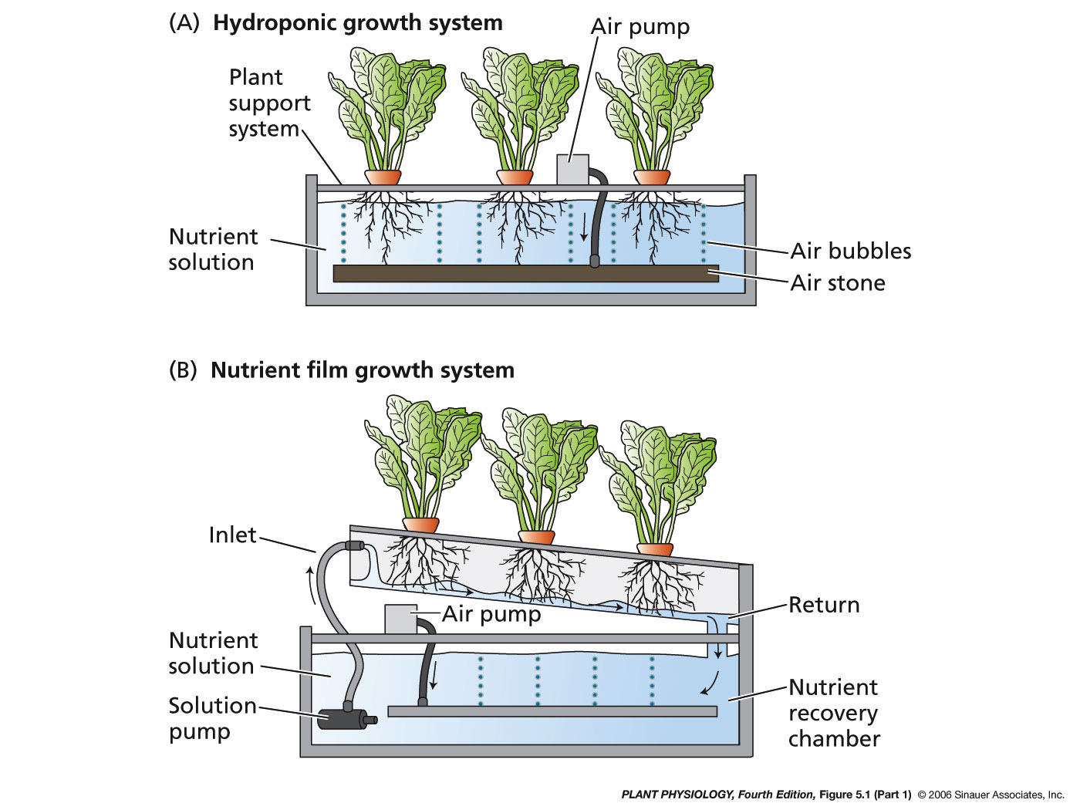

Slide 19
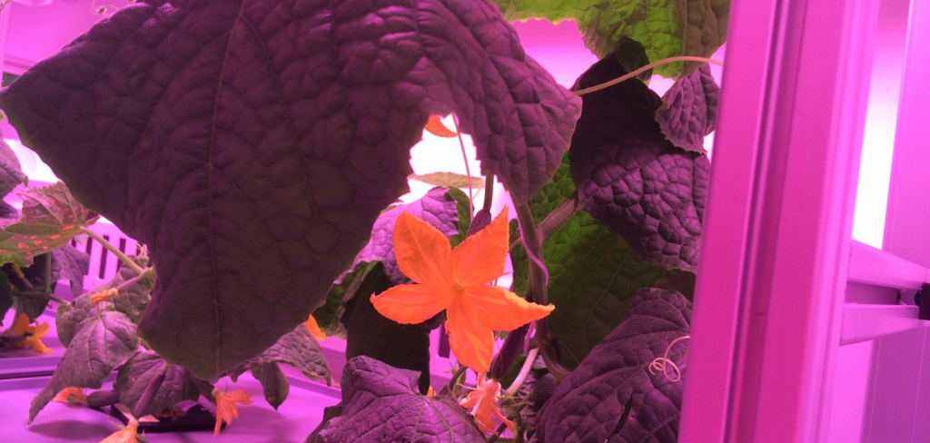

Slide 20
https://www.youtube.com/watch?v=F_WuJ9P1u-k

Slide 21
Hydroponics

Slide 22
Hydroponics
At
https://www.2lua.vn/agritec/hydroponics-calculator.html?hl=en
You can see the basics of an hydroponic calculator that
Combines plants needs with the available chemicals in order to rich a certain production.
Try!

Slide 23
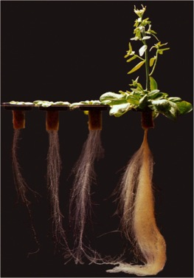
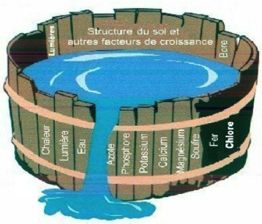
Justus von Leibig (1844)
Estabelece através da experimentação o carácter puramente mineral da nutrição vegetal.
Análise da composição química das cinzas
Hidroponia
Lei do mínimo
Hidroponia

Slide 24
Plant nutrient deficiency symptoms:
Are the expression of metabolic disorders resulting from insufficient supply of an essential nutrient.
These are related to the roles played by essential elements in normal plant metabolism and functions (see slide 16).
Consider to which extent an element can be recycled from older to younger leaves (see slide 15).

Slide 25
Nutrient defficiency
FV- nutrição

Slide 26
26

Slide 27
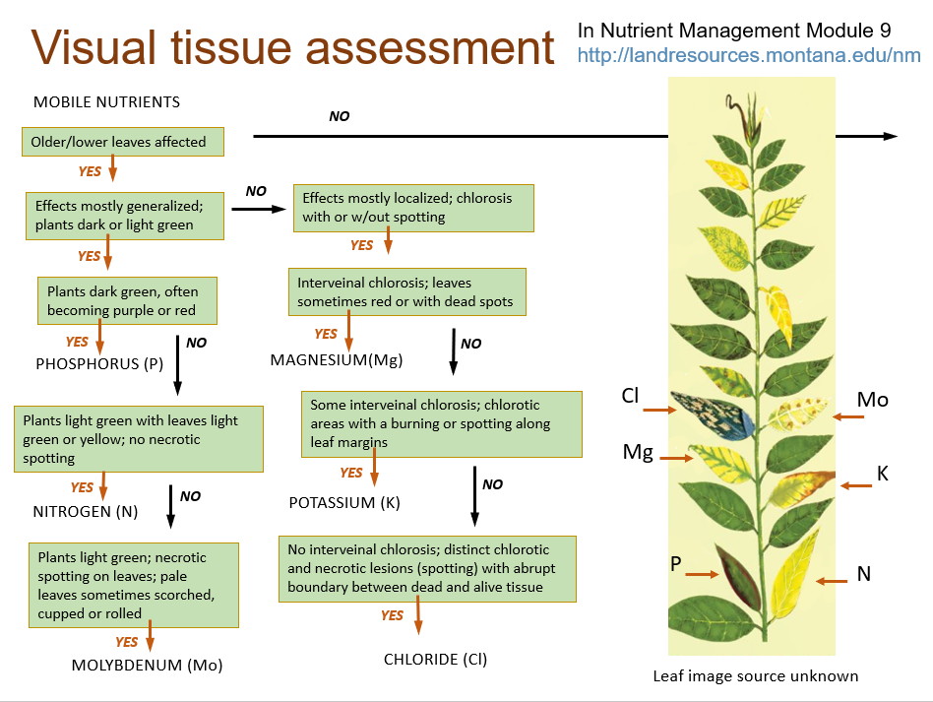

Slide 28
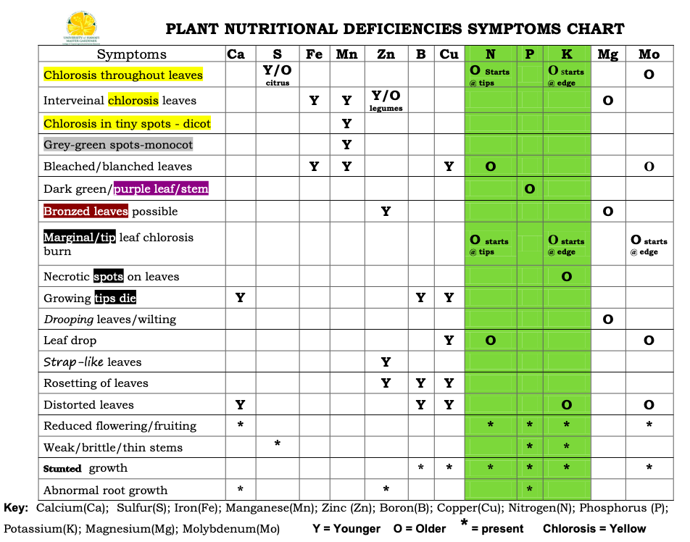
28

Slide 29
Plant tissue analysis is routinely used by farmers for N, P and K;
Can be done for different plant tissues and organs (leaves of different ages and positions, stems, roots, fruits, etc.)
More accurate than visual symptoms analysis; can be used to correct deficiencies
29

